Slide 1

VHDL (State Machine)
Winter 1400 (Computer Aided Design)
Meisam Abdollahi
School of Computer Engineering
Iran University of Science and Technology
meisam.abdolahi@ut.ac.ir

Slide 2
Outline
Structure of a Digital System
State Machines
Moore Machine
Mealy Machine
Moore Machine in VHDL
Mealy Machine in VHDL
How to Design Optimum State Machines

Slide 3
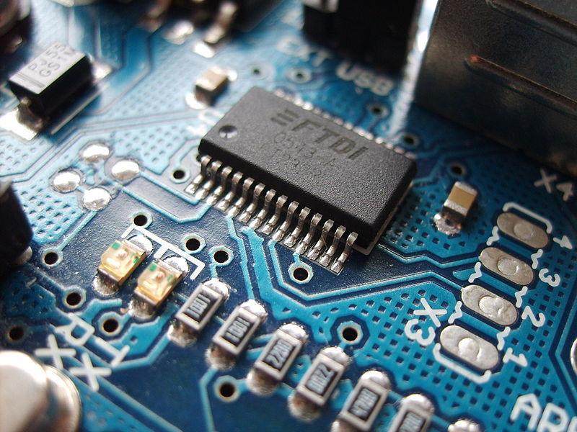
Structure of Digital Systems

Slide 4
Structure of a Typical Digital System
Data Inputs
Control Inputs
Control
Signals
Datapath
(Execution
Unit)
Controller
(Control
Unit)
Status
Signals
Data Outputs
Control Outputs

Slide 5
Datapath (Execution Unit)
Manipulates and processes data
Performs arithmetic and logic operations, shifting, and other data-processing tasks
Composed of registers, gates, multiplexers, decoders, adders, comparators, ALUs, etc.
Provides all necessary resources and interconnects among them to perform specified task
Interprets control signals from the Controller and generates status signals for the Controller

Slide 6
Controller (Control Unit)
A controller controls data movements in the datapath by switching multiplexers and enabling or disabling resources
Example: enable signals for Registers
Example: control signals for Muxes
Provides signals to activate various processing tasks in the Datapath
Determines the sequence of the operations performed by Datapath

Slide 7
Controller
Controller can be programmable or non-programmable
Programmable
Has a program counter which points to the next instruction
Instructions are held in a RAM or ROM externally
Micro-programming is an example of programmable controller
Non-Programmable
It is a “hardwired state machine” or “hardwired instructions”
We will be focusing primarily on the non-programmable type in this course

Slide 8
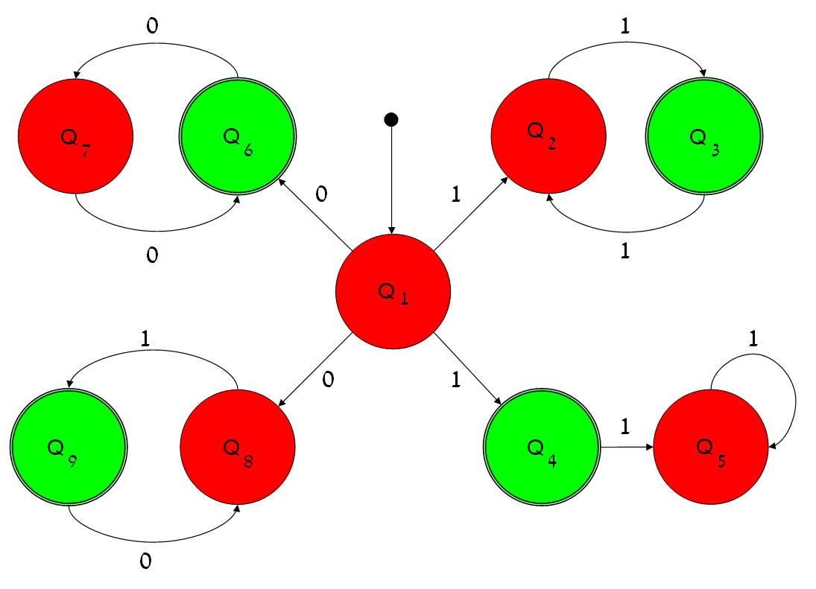
Finite State Machine

Slide 9
Finite State Machines (I)
Digital Systems and especially their Controllers can be described as Finite State Machines (FSMs)
Finite State Machines can be represented using
State Diagrams and State Tables - suitable for simple digital systems with a relatively few inputs and outputs
Algorithmic State Machine (ASM) Charts - suitable for complex digital systems with a large number of inputs and outputs

Slide 10
Finite State Machines (II)
Any Circuit with Memory is a Finite State Machine
Even computers can be viewed as huge FSMs
Design of FSMs involves
Defining states
Defining transitions between states
Determining the output
Optimization / minimization
Manual Optimization/Minimization is Practical for Small FSMs Only

Slide 11
Moore FSM
Output is a Function of a Present State Only
clock
Present
State register
Inputs
Next State
function
Outputs
Output
function
reset
Current state

Slide 12
Mealy FSM
Output Is a Function of a Present State and Inputs
clock
Present
State register
Inputs
Next State
function
Output
function
Outputs
reset
Current state

Slide 13
Moore Machine
transition
condition 1
state 1
output 1
state 2
output 2
transition
condition 2

Slide 14
Mealy Machine
transition condition 1
output 1
state 1
state 2
transition condition 2
output 2

Slide 15
Moore vs. Mealy FSM (I)
Moore and Mealy FSMs Can Be Functionally Equivalent
Equivalent Mealy FSM can be derived from Moore FSM and vice versa
Mealy FSM Has Richer Description and Usually Requires Smaller Number of States
Smaller circuit area

Slide 16
Moore vs. Mealy FSM (II)
Mealy FSM Computes Outputs as soon as Inputs Change
Mealy FSM responds one clock cycle sooner than equivalent Moore FSM
Moore machine is synchronize with clock, but Mealy machine is not

Slide 17
Moore FSM - Example 1
Moore FSM that Recognizes Sequence “10”
0
1
0
S0/0
1
S1/0
S2/1
1
reset
0
S0: No
elements
of the
sequence
observed
S1: “1”
observed
S2: “10”
observed
Meaning
of states:

Slide 18
Mealy FSM - Example 1
Mealy FSM that Recognizes Sequence “10”
0 / 0
1 / 0
1 / 0
S0
S1
reset
0 / 1
S0: No
elements
of the
sequence
observed
S1: “1”
observed
Meaning
of states:

Slide 19
Moore & Mealy FSMs – Example 1
clock
0 1 0 0 0
input
S0 S1 S2 S0 S0
Moore
S0 S1 S0 S0 S0
Mealy

Slide 20
Finite State Machines
in VHDL

Slide 21
FSMs in VHDL
Finite State Machines can be easily described with processes
Synthesis Tools understand FSM description if certain rules are followed:
State transitions should be described in a process sensitive to clock and reset signals
Outputs described as concurrent statements outside the process

Slide 22
Moore FSM in VHDL
clock
Present State register
Inputs
Next State
function
Outputs
Output
function
reset
concurrent
statements
Current state
process(clock, reset)

Slide 23
Moore FSM - Example (I)
Moore FSM that Recognizes Sequence “10”
0
1
0
S0/0
1
S1/0
S2/1
1
reset
0

Slide 24
Moore Example (II)
LIBRARY ieee;
USE ieee.std_logic_1164.ALL;
ENTITY sequencer is
PORT(clk, reset, input : IN std_logic;
output: OUT std_logic);
End ENTITY;
Architecture moore of sequencer is
TYPE state iS (S0, S1, S2); -- state declaration
SIGNAL Moore_state: state;
BEGIN
U_Moore: PROCESS (clk, reset)
begin
IF (reset = ‘1’) THEN
Moore_state <= S0;
ELSIF (clk’event AND clk=‘1’) THEN
CASE Moore_state IS
WHEN S0 =>
IF input = ‘1’ THEN
Moore_state <= S1;
ELSE
Moore_state <= S0;
END IF;

Slide 25
Moore Example (III)
WHEN S1 =>
IF input = ‘0’ THEN
Moore_state <= S2;
ELSE
Moore_state <= S1;
END IF;
WHEN S2 =>
IF input = ‘0’ THEN
Moore_state <= S0;
ELSE
Moore_state <= S1;
END IF;
END CASE;
END IF;
END PROCESS;
Output <= ‘1’ WHEN Moore_state = S2 ELSE ‘0’;
END Architecture;
Output: concurrent statements

Slide 26
Mealy FSM in VHDL
Output is a Function of a Present State and Inputs
clock
Present State register
Inputs
Next State
function
Output
function
Outputs
reset
concurrent
statements
Current state
process(clock, reset)

Slide 27
Mealy FSM - Example (I)
Mealy FSM that Recognizes Sequence “10”
0 / 0
1 / 0
1 / 0
S0
S1
reset
0 / 1

Slide 28
Mealy Example (II)
LIBRARY ieee;
USE ieee.std_logic_1164.ALL;
ENTITY sequencer is
PORT(clk, reset, input : IN std_logic;
output: OUT std_logic);
End ENTITY;
Architecture Mealy of sequencer is
TYPE state IS (S0, S1);
SIGNAL Mealy_state: state;
BEGIN
U_Mealy: PROCESS(clk, reset)
BEGIN
IF(clk’event AND clk = ‘1’) THEN
IF reset=‘1’ THEN
Mealy_state <= S0;
ELSE
CASE Mealy_state IS
WHEN S0 =>
IF input = ‘1’ THEN
Mealy_state <= S1;
ELSE
Mealy_state <= S0;
END IF;

Slide 29
Mealy Example (III)
WHEN S1 =>
IF input = ‘0’ THEN
Mealy_state <= S0;
ELSE
Mealy_state <= S1;
END IF;
END CASE;
END IF;
END IF;
END PROCESS;
Output <= ‘1’ WHEN (Mealy_state = S1 AND input = ‘0’) ELSE ‘0’;
END Architecture;

Slide 30
Moore FSM - Example (II)
resetn
w
=
1
A
/
/
w
=
0
z
=
0
B
z
=
0
w
=
0
w
=
0
w
=
1
C
/
z
=
1
w
=
1

Slide 31
Moore FSM – State table
Present
Next state
Output
state
w
=
0
w
=
1
z
A
A
B
0
B
A
C
0
C
A
C
1

Slide 32
Moore FSM Example 2: VHDL code (I)
Library ieee;
USE ieee.std_logic_1164.all ;
ENTITY simple IS
PORT ( clock : IN STD_LOGIC ;
resetn : IN STD_LOGIC ;
w : IN STD_LOGIC ;
z : OUT STD_LOGIC ) ;
END simple ;
ARCHITECTURE Behavior OF simple IS
TYPE State_type IS (A, B, C) ;
SIGNAL y : State_type ;
BEGIN
PROCESS ( resetn, clock )
BEGIN
IF resetn = '0' THEN
y <= A ;
ELSIF (Clock'EVENT AND Clock = '1') THEN

Slide 33
Moore FSM Example 2: VHDL code (II)
CASE y IS
WHEN A =>
IF w = '0' THEN
y <= A ;
ELSE
y <= B ;
END IF ;
WHEN B =>
IF w = '0' THEN
y <= A ;
ELSE
y <= C ;
END IF ;
WHEN C =>
IF w = '0' THEN
y <= A ;
ELSE
y <= C ;
END IF ;
END CASE ;

Slide 34
Moore FSM Example 2: VHDL code (III)
END IF ;
END PROCESS ;
z <= '1' WHEN y = C ELSE '0' ;
END Behavior ;

Slide 35
Mealy FSM - Example (II)
resetn
w
=
1
/
z
=
0
w
=
0
/
/
z
=
0
A
B
w
=
1
z
=
1
w
=
0
/
z
=
0

Slide 36
Mealy FSM – State table
Present
Next state
Output
z
state
w
=
0
w
=
1
w
=
0
w
=
1
A
A
B
0
0
B
A
B
0
1

Slide 37
Mealy FSM Example 2: VHDL code
LIBRARY ieee ;
USE ieee.std_logic_1164.all ;
ENTITY Mealy IS
PORT ( clock : IN STD_LOGIC ;
resetn : IN STD_LOGIC ;
w : IN STD_LOGIC ;
z : OUT STD_LOGIC ) ;
END Mealy ;
ARCHITECTURE Behavior OF Mealy IS
TYPE State_type IS (A, B) ;
SIGNAL y : State_type ;
BEGIN
PROCESS ( resetn, clock )
BEGIN
IF resetn = '0' THEN
y <= A ;
ELSIF (clock'EVENT AND clock = '1') THEN

Slide 38
Mealy FSM Example 2: VHDL code
CASE y IS
WHEN A =>
IF w = '0' THEN
y <= A ;
ELSE
y <= B ;
END IF ;
WHEN B =>
IF w = '0' THEN
y <= A ;
ELSE
y <= B ;
END IF ;
END CASE ;
END IF ;
END PROCESS ;
WITH y SELECT
z <= w WHEN B,
‘0’ WHEN others;
END Behavior ;

Slide 39
Design an Optimum State Machine
Select the state machine depends on type and constrains of design
Time schedule
Area
Speed
Outputs without wavelet
Use a combination of Mealy and Moore

Slide 40
Outline
Design Style #1
BCD Counter
Design Style #2 (Stored Output)
String Detector
Traffic Light Controller (TLC)

Slide 41
Design Style #1

Slide 42
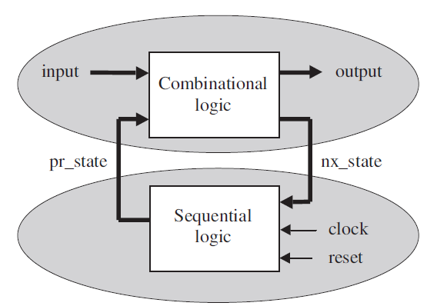
Mealy state machine diagram
The sequential code can implement both types of logic, combinational as well as sequential.
If desired, the upper part can also be implemented using a PROCESS.
The separation of the circuit into two sections allows the design to be broken into two parts:
The lower part, being sequential, will require a PROCESS,
While the upper part, being combinational, will not

Slide 43
Design of the Lower (Sequential) Section
PROCESS (reset, clock)
BEGIN
IF (reset='1') THEN
pr_state <= state0;
ELSIF (clock'EVENT AND clock='1') THEN
pr_state <= nx_state;
END IF;
END PROCESS;
It consists of an asynchronous reset, which determines the initial state of the system (state0),
The synchronous storage of nx_state (at the positive transition of clock)
One good thing about this approach is that the design of the lower section is basically standard.
Another advantage of this design style is that the number of registers is minimum.

Slide 44
Design of the Upper (Combinational) Section
PROCESS (input, pr_state)
BEGIN
CASE pr_state IS
WHEN state0 =>
IF (input = ...) THEN
output <= <value>;
nx_state <= state1;
ELSE ...
END IF;
WHEN state1 =>
IF (input = ...) THEN
output <= <value>;
nx_state <= state2;
ELSE ...
END IF;
WHEN state2 =>
IF (input = ...) THEN
output <= <value>;
nx_state <= state2;
ELSE ...
END IF;
...
END CASE;
END PROCESS;
It does two things:
it assigns the output value and
it establishes the next state.
Note that all input signals are present in the sensitivity list and all input/output combinations are specified

Slide 45
State Machine Template for Design Style #1
LIBRARY ieee;
USE ieee.std_logic_1164.all;
-----------------------------------------------------
ENTITY <entity_name> IS
PORT ( input: IN <data_type>;
reset, clock: IN STD_LOGIC;
output: OUT <data_type>);
END <entity_name>;
-----------------------------------------------------
ARCHITECTURE <arch_name> OF <entity_name> IS
TYPE state IS (state0, state1, state2, state3, ...);
SIGNAL pr_state, nx_state: state;
BEGIN
---------- Lower section: ------------------------
PROCESS (reset, clock)
BEGIN
IF (reset='1') THEN
pr_state <= state0;
ELSIF (clock'EVENT AND clock='1') THEN
pr_state <= nx_state;
END IF;
END PROCESS;
---------- Upper section: ------------------------
PROCESS (input, pr_state)
BEGIN
CASE pr_state IS
WHEN state0 =>
IF (input = ...) THEN
output <= <value>;
nx_state <= state1;
ELSE ...
END IF;
WHEN state1 =>
IF (input = ...) THEN
output <= <value>;
nx_state <= state2;
ELSE ...
END IF;
WHEN state2 =>
IF (input = ...) THEN
output <= <value>;
nx_state <= state3;
ELSE ...
END IF;
...
END CASE;
END PROCESS;
END <arch_name>;

Slide 46
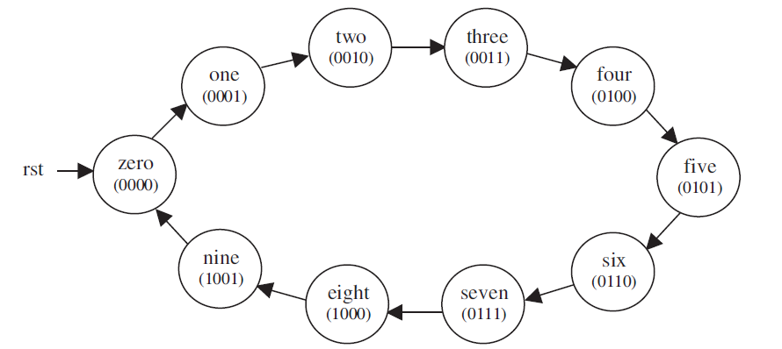
Example: BCD Counter

Slide 47
Example: BCD Counter (II)
1 -------------------------------------------------
2 LIBRARY ieee;
3 USE ieee.std_logic_1164.all;
4 -------------------------------------------------
5 ENTITY counter IS
6 PORT ( clk, rst: IN STD_LOGIC;
7 count: OUT STD_LOGIC_VECTOR (3 DOWNTO 0));
8 END counter;
9 -------------------------------------------------
10 ARCHITECTURE state_machine OF counter IS
11 TYPE state IS (zero, one, two, three, four,
12 five, six, seven, eight, nine);
13 SIGNAL pr_state, nx_state: state;
14 BEGIN
15 ------------- Lower section: -----------------
16 PROCESS (rst, clk)
17 BEGIN
18 IF (rst='1') THEN
19 pr_state <= zero;
20 ELSIF (clk'EVENT AND clk='1') THEN
21 pr_state <= nx_state;
22 END IF;
23 END PROCESS;

Slide 48
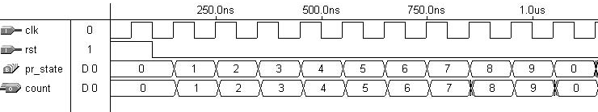
Example: BCD Counter (III)
24 ------------- Upper section: -----------------
25 PROCESS (pr_state)
26 BEGIN
27 CASE pr_state IS
28 WHEN zero =>
29 count <= "0000";
30 nx_state <= one;
31 WHEN one =>
32 count <= "0001";
33 nx_state <= two;
34 WHEN two =>
35 count <= "0010";
36 nx_state <= three;
37 WHEN three =>
38 count <= "0011";
39 nx_state <= four;
40 WHEN four =>
41 count <= "0100";
42 nx_state <= five;
43 WHEN five =>
44 count <= "0101";
45 nx_state <= six;
46 WHEN six =>
47 count <= "0110";
48 nx_state <= seven;
49 WHEN seven =>
50 count <= "0111";
51 nx_state <= eight;
52 WHEN eight =>
53 count <= "1000";
54 nx_state <= nine;
55 WHEN nine =>
56 count <= "1001";
57 nx_state <= zero;
58 END CASE;
59 END PROCESS;
60 END state_machine;

Slide 49
Design Style #2 (Stored Output)

Slide 50
Design Style #2 (Stored Output)
in design style #1 only pr_state is stored
In many applications, the signals are required to be synchronous, so the output should be updated only when the proper clock edge occurs
To make Mealy machines synchronous, the output must be stored as well
This structure is the object of design style #2
To implement this new structure, very few modifications are needed
we can use an additional signal (say, temp) to compute the output value (upper section), but only pass its value to the actual output signal when a clock event occurs (lower section).

Slide 51
Design Style #1 vs. #2
input
temp
Combinational
logic
pr_state
nx_state
Sequential
logic
output
clock
rst
Style #1
Style #2

Slide 52
Design Style #2 (Stored Output)
ENTITY <ent_name> IS
PORT (input: IN <data_type>;
reset, clock: IN STD_LOGIC;
output: OUT <data_type>);
END <ent_name>;
-------------------------------------------------------
ARCHITECTURE <arch_name> OF <ent_name> IS
TYPE states IS (state0, state1, state2, state3, ...);
SIGNAL pr_state, nx_state: states;
SIGNAL temp: <data_type>;
BEGIN
---------- Lower section: --------------------------
PROCESS (reset, clock)
BEGIN
IF (reset='1') THEN
pr_state <= state0;
ELSIF (clock'EVENT AND clock='1') THEN
output <= temp;
pr_state <= nx_state;
END IF;
END PROCESS;

Slide 53
Design Style #2 (Stored Output)
---------- Upper section: --------------------------
PROCESS (pr_state)
BEGIN
CASE pr_state IS
WHEN state0 =>
temp <= <value>;
IF (condition) THEN nx_state <= state1;
...
END IF;
WHEN state1 =>
temp <= <value>;
IF (condition) THEN nx_state <= state2;
...
END IF;
WHEN state2 =>
temp <= <value>;
IF (condition) THEN nx_state <= state3;
...
END IF;
...
END CASE;
END PROCESS;
END <arch_name>;

Slide 54
Example: String Detector
We want to design a circuit that takes as input a serial bit stream and outputs a ‘1’ whenever the sequence ‘‘111’’ occurs.
Overlaps must also be considered, that is, if . . .0111110 . . . occurs, than the output should remain active for three consecutive clock cycles.

Slide 55
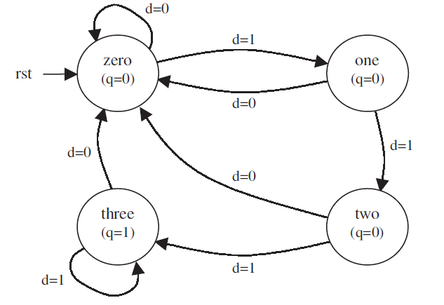
Style #2 Design of string detector

Slide 56
Style #2 Design of string detector (Implementation)
5 ENTITY string_detector IS
6 PORT ( d, clk, rst: IN BIT;
7 q: OUT BIT);
8 END string_detector;
9 --------------------------------------------
10 ARCHITECTURE my_arch OF string_detector IS
11 TYPE state IS (zero, one, two, three);
12 SIGNAL pr_state, nx_state: state;
13 SIGNAL temp: BIT;
14 BEGIN
15 ----- Lower section: --------------------
16 PROCESS (rst, clk)
17 BEGIN
18 IF (rst='1') THEN
19 pr_state <= zero;
20 ELSIF (clk'EVENT AND clk='1') THEN
21 pr_state <= nx_state;
22 q<=temp;
22 END IF;
23 END PROCESS;

Slide 57
Style #2 Design of string detector (Implementation)
23 ---------- Upper section: ---------------
24 PROCESS (d, pr_state)
25 BEGIN
26 CASE pr_state IS
27 WHEN zero =>
28 temp <= '0';
29 IF (d='1') THEN nx_state <= one;
30 ELSE nx_state <= zero;
31 END IF;
32 WHEN one =>
33 temp <= '0';
34 IF (d='1') THEN nx_state <= two;
35 ELSE nx_state <= zero;
36 END IF;
37 WHEN two =>
38 temp <= '0';
39 IF (d='1') THEN nx_state <= three;
40 ELSE nx_state <= zero;
41 END IF;
42 WHEN three =>
43 temp <= '1';
44 IF (d='0') THEN nx_state <= zero;
45 ELSE nx_state <= three;
46 END IF;
47 END CASE;
48 END PROCESS;
49 END my_arch;

Slide 58
Traffic Light Controller (TLC)

Slide 59
Traffic Logic Controller
Three modes of operation: Regular, Test, and Standby
Regular mode: four states, each with an independent, programmable time, passed to the circuit by means of a CONSTANT
Test mode: allows all pre-programmed times to be overwritten (by a manual switch) with a small value, such that the system can be easily tested during maintenance (1 second per state).
Standby mode: if set the system should activate the yellow lights in both directions and remain so while the standby signal is active.
Assume that a 60 Hz clock (obtained from the power line itself ) is available

Slide 60
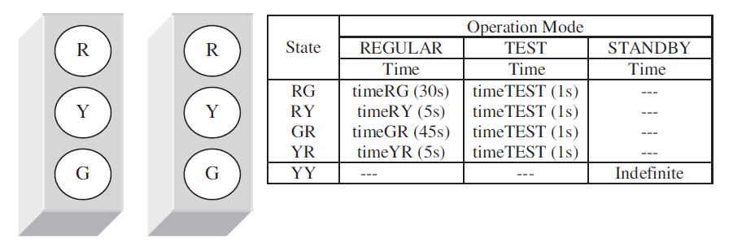
Traffic Logic Controller (II)

Slide 61
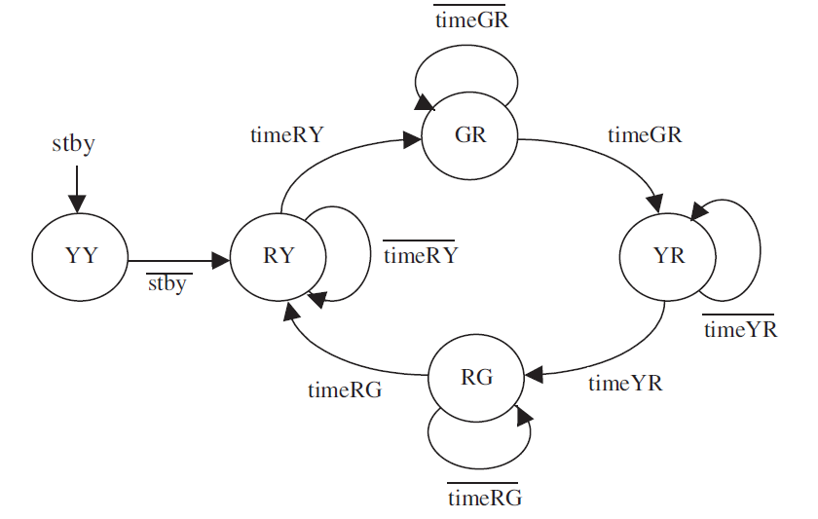
Traffic Logic Controller (III)

Slide 62
Traffic Logic Controller Implementation (I)
5 ENTITY tlc IS
6 PORT ( clk, stby, test: IN STD_LOGIC;
7 r1, r2, y1, y2, g1, g2: OUT STD_LOGIC);
8 END tlc;
9 -------------------------------------------------
10 ARCHITECTURE behavior OF tlc IS
11 CONSTANT timeMAX : INTEGER := 2700;
12 CONSTANT timeRG : INTEGER := 1800;
13 CONSTANT timeRY : INTEGER := 300;
14 CONSTANT timeGR : INTEGER := 2700;
15 CONSTANT timeYR : INTEGER := 300;
16 CONSTANT timeTEST : INTEGER := 60;
17 TYPE state IS (RG, RY, GR, YR, YY);
18 SIGNAL pr_state, nx_state: state;
19 SIGNAL time : INTEGER RANGE 0 TO timeMAX;
20 BEGIN
21 -------- Lower section of state machine: ---
22 PROCESS (clk, stby)
23 VARIABLE count : INTEGER RANGE 0 TO timeMAX;
24 BEGIN
25 IF (stby='1') THEN
26 pr_state <= YY;
27 count := 0;
28 ELSIF (clk'EVENT AND clk='1') THEN
29 count := count + 1;
30 IF (count = time) THEN
31 pr_state <= nx_state;
32 count := 0;
33 END IF;
34 END IF;
35 END PROCESS;

Slide 63
Traffic Logic Controller Implementation (II)
36 -------- Upper section of state machine: ----
37 PROCESS (pr_state, test)
38 BEGIN
39 CASE pr_state IS
40 WHEN RG =>
41 r1<='1'; r2<='0'; y1<='0'; y2<='0'; g1<='0'; g2<='1';
42 nx_state <= RY;
43 IF (test='0') THEN time <= timeRG;
44 ELSE time <= timeTEST;
45 END IF;
46 WHEN RY =>
47 r1<='1'; r2<='0'; y1<='0'; y2<='1'; g1<='0'; g2<='0';
48 nx_state <= GR;
49 IF (test='0') THEN time <= timeRY;
50 ELSE time <= timeTEST;
51 END IF;
52 WHEN GR =>
53 r1<='0'; r2<='1'; y1<='0'; y2<='0'; g1<='1'; g2<='0';
54 nx_state <= YR;
55 IF (test='0') THEN time <= timeGR;
56 ELSE time <= timeTEST;
57 END IF;
58 WHEN YR =>
59 r1<='0'; r2<='1'; y1<='1'; y2<='0'; g1<='0'; g2<='0';
60 nx_state <= RG;
61 IF (test='0') THEN time <= timeYR;
62 ELSE time <= timeTEST;
63 END IF;
64 WHEN YY =>
65 r1<='0'; r2<='0'; y1<='1'; y2<='1'; g1<='0'; g2<='0';
66 nx_state <= RY;
67 END CASE;
68 END PROCESS;
69 END behavior;

Slide 64
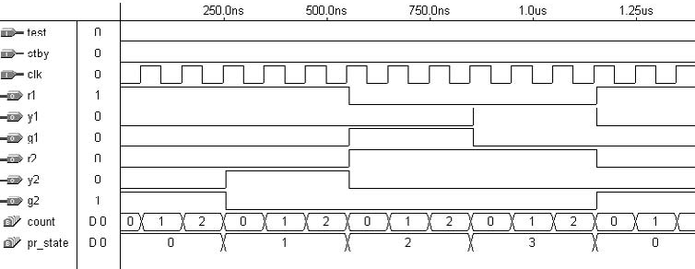
TLC Simulation Result

